Slide 1
State of the Division Work Session Preview
October 11, 2018

Slide 2
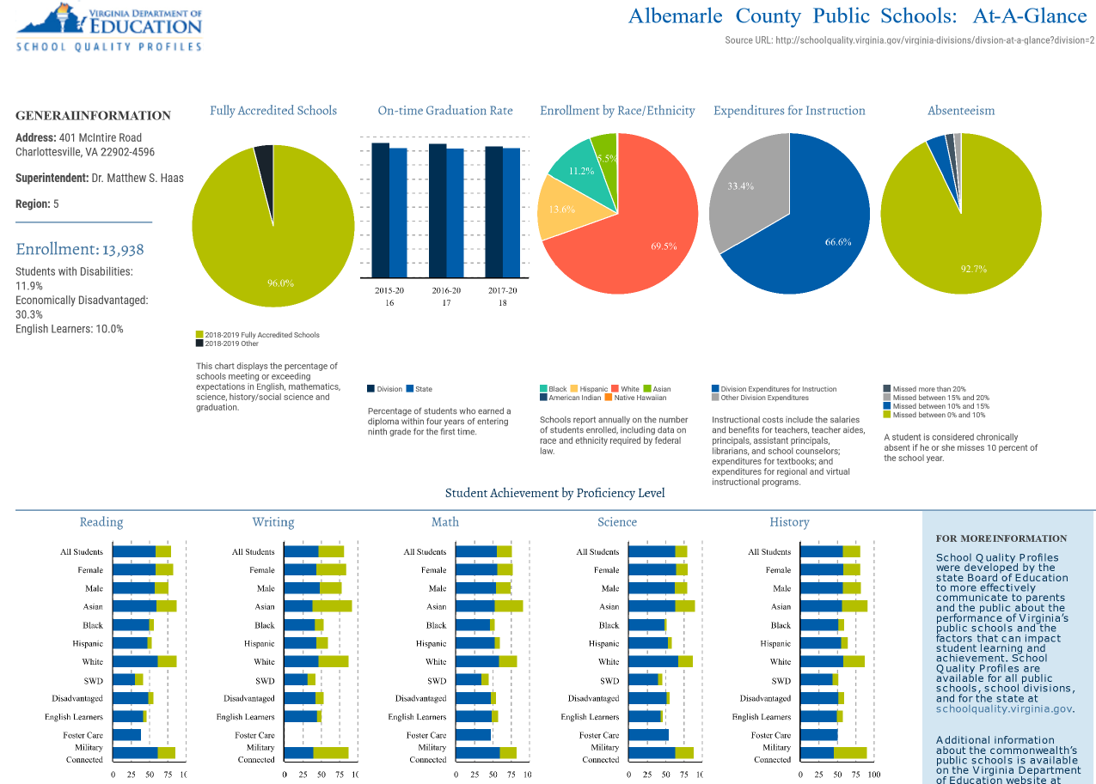
School Quality Profile—ACPS At-a-Glance
Accredited Schools
On-Time Graduation Rate
Enrollment by Ethnicity
Expenditures for Instruction
Absenteeism
Student Achievement

Slide 3
State of the Division—October 25
Purpose
  Report on results from the 2017-2018 school year
  Use as a springboard to developing budget priorities for 2019-2020
Work session format
  Overview of the full school quality profile for ACPS
  Deeper dive into data tied to our strategic priorities
    Priority One: High Achievement for All
      SOL data
    Priority Two: Closing the Achievement Gap
      Equity Dashboard data
    Priority Three: Developing Personal Interests
      School Climate Data

Slide 4
Questions?

